Slide 1


ANZ –Virtual Internship
Task 1
Exploratory Data Analysis
- Abhijit Biswas

Slide 2
Basic Findings for
ANZ management
About 80% of the transactions are between 0.1 – 60 AUD.
2. The ratio of the customers who performs transactions is almost 1:1 w.r.t gender.
3. Majority of the transactions are of SALES-POS and PAYMENT type.
4. Majority of the transactions are debit movement.
5. Majority of the users age is less than 40.
6. The Average transaction amount is 187.934 AUD

Slide 3
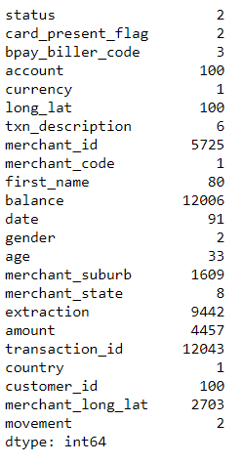
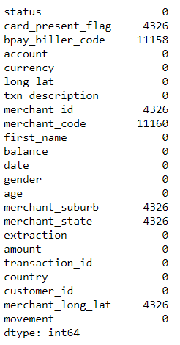
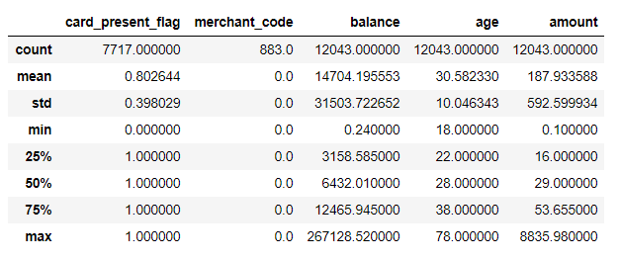
Fig : Null
Fig : Unique Columns
Fig : Describe Dataset

Slide 4
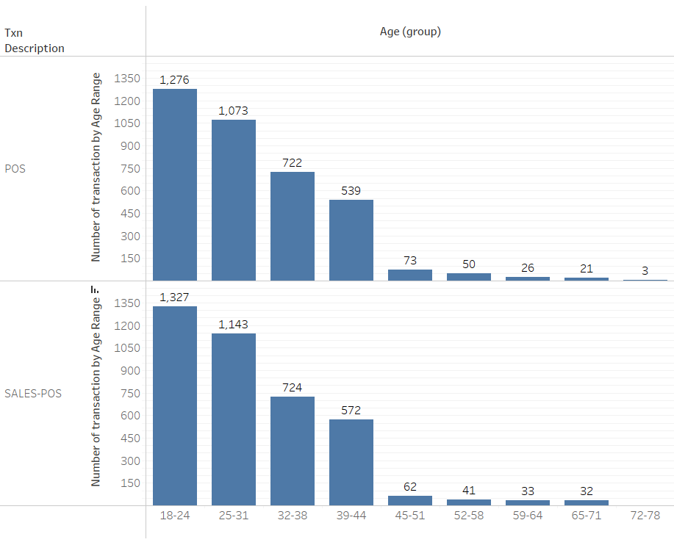
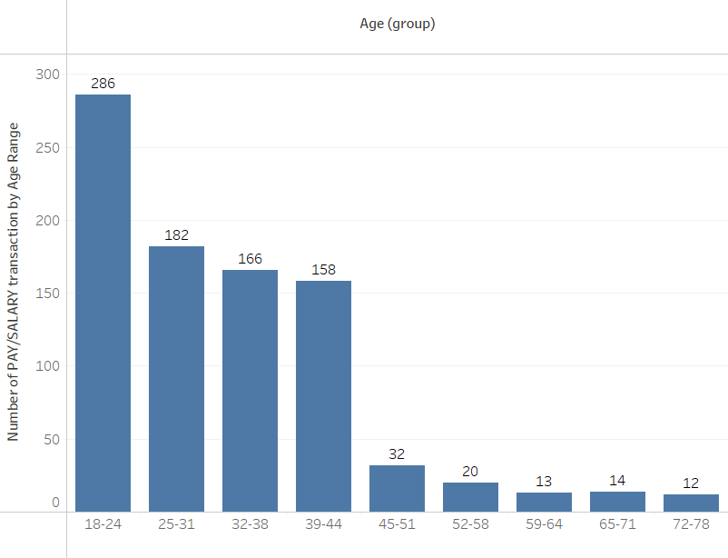
Fig: Total number of POS/SALES-POS transactions
by Age Range
Fig: Total number of PAY/SALARY transactions
by Age Range

Slide 5
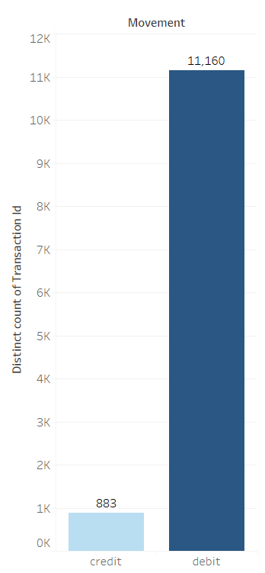
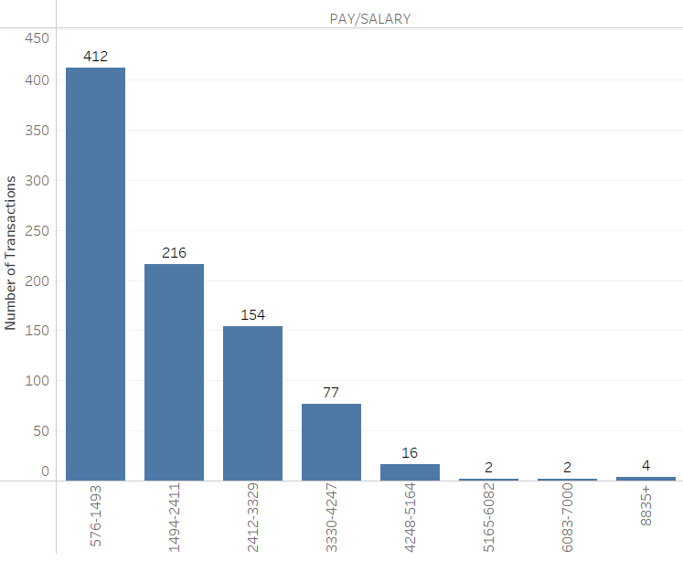
Fig : Types of transactions by the customers
Fig: Total number of transactions
by Salary Range

Slide 6
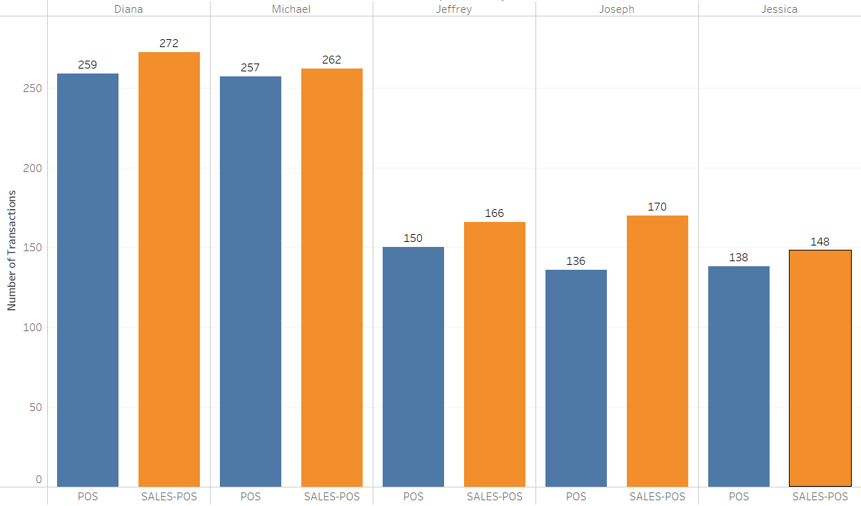
Fig: Total number of POS/POS-SALES transactions
by top 5 customers

Slide 7
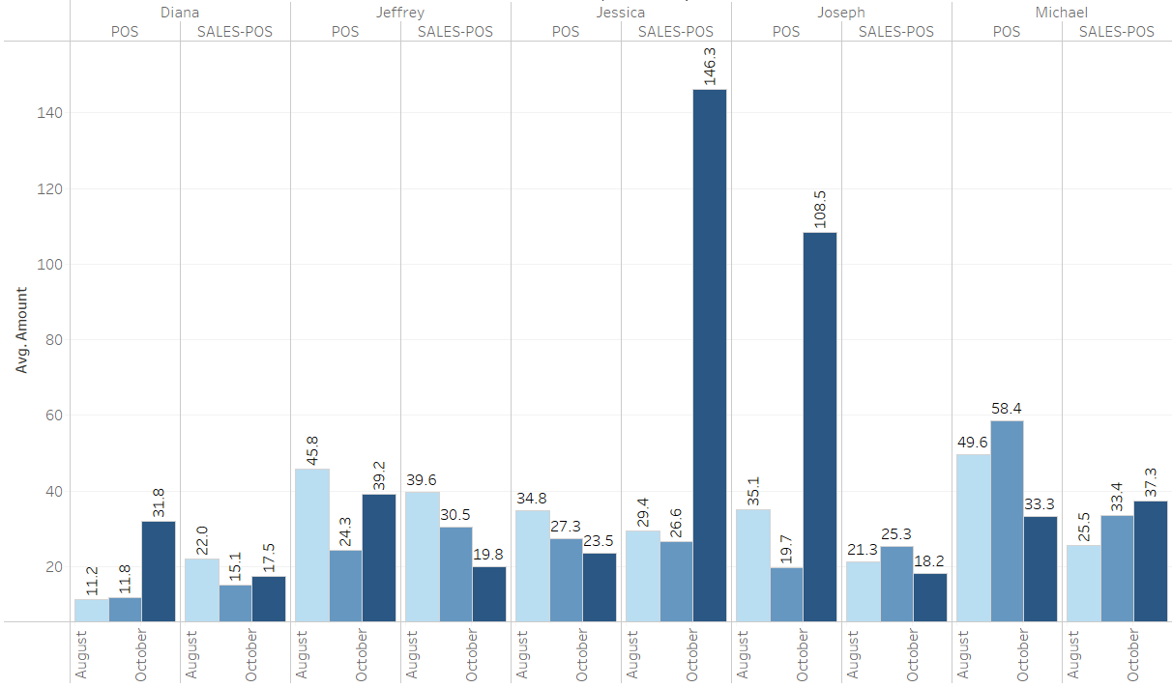
Fig: Average number of POS/POS-SALES per month
by top 5 customers

Slide 8
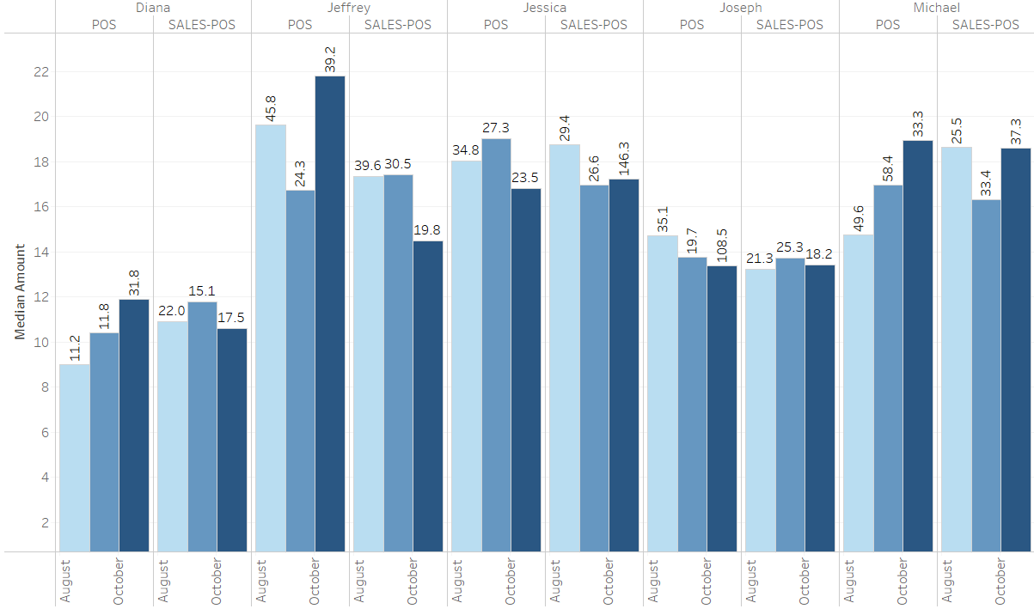
Fig: Median of POS/POS-SALES per month
by top 5 customers

Slide 9
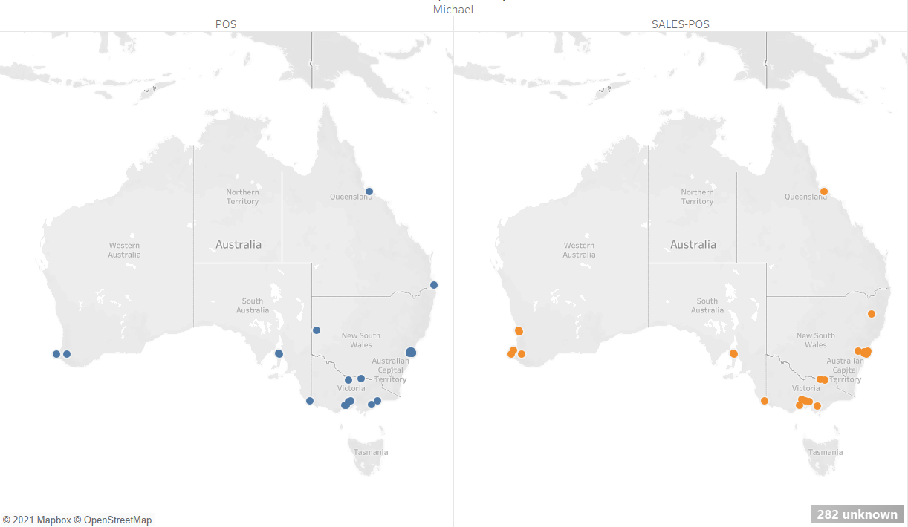
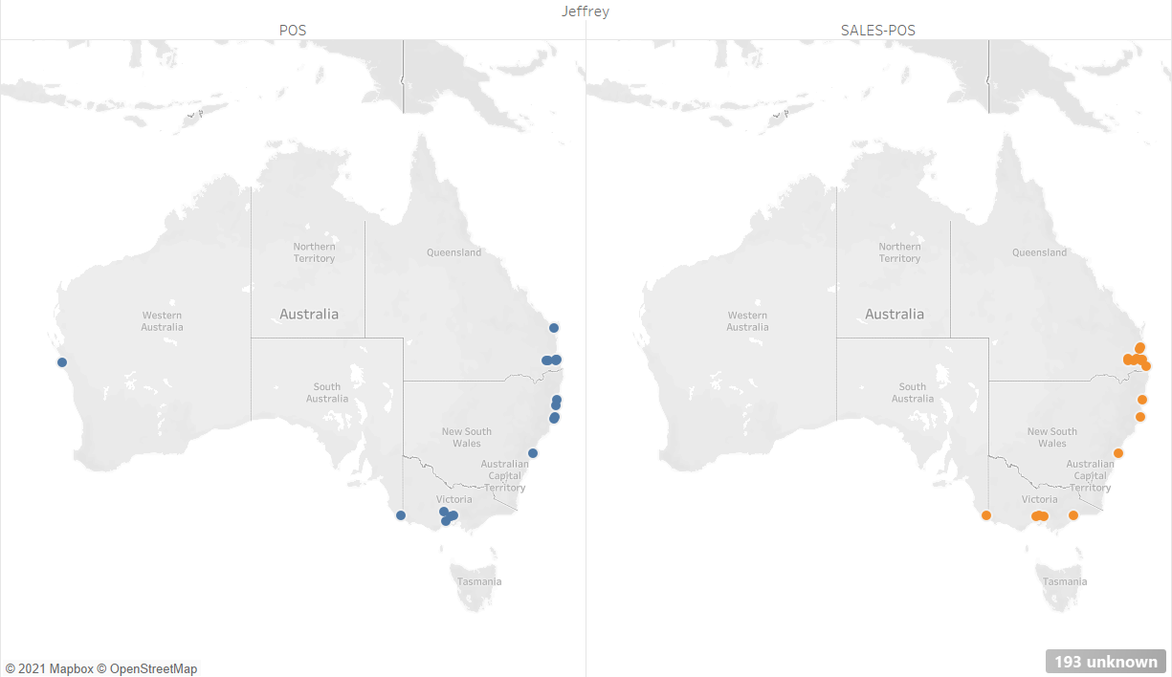


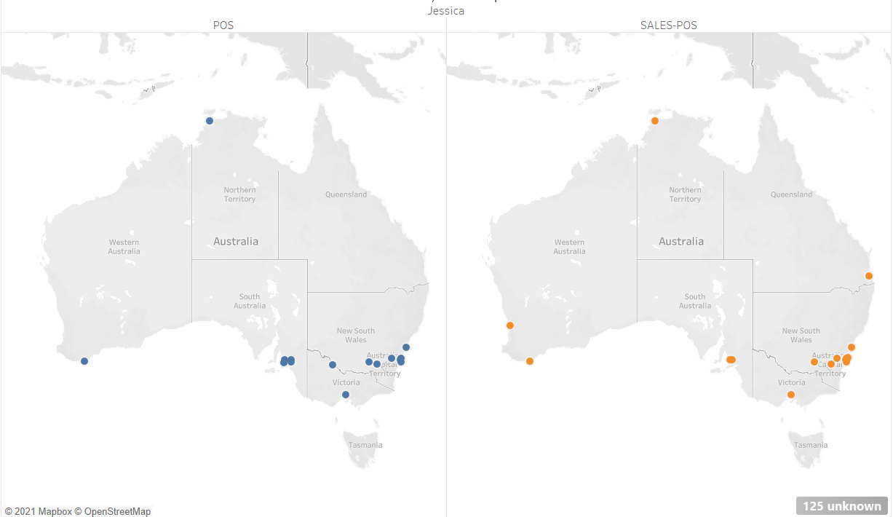
Fig: Locations of transaction of
top 5 customers

